Slide 1
Virtual Memory – Remaining topics

Slide 2
Agenda
Problem of Thrashing and possible solutions
Mmap(), Memory mapped files
Kernel Memory Management
Other Considerations

Slide 3
Thrashing

Slide 4
Thrashing
If a process does not have “enough” pages, the page-fault rate is very high
  Page fault to get page
  Replace existing frame
  But quickly need replaced frame back
This leads to:
  Low CPU utilization
  Operating system thinking that it needs to increase the degree of multiprogramming
  Another process added to the system
Thrashing : a process is busy swapping pages in and out

Slide 5
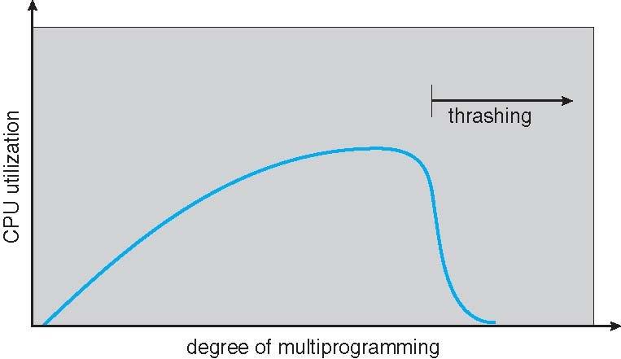
Thrashing

Slide 6
Demand paging and thrashing
Why does demand paging work?
  Locality model
  Process migrates from one locality to another
  Localities may overlap
Why does thrashing occur?
  size of locality > total memory size
  Limit effects by using local or priority page replacement

Slide 7
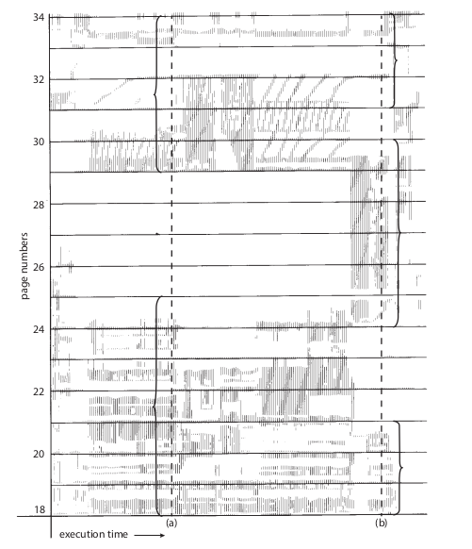
Locality In A Memory-Reference Pattern

Slide 8
Working set model
∆ ≡ working-set window ≡ a fixed number of page references
  Example: 10,000 instructions
Working Set Size, WSS_{i} (working set of Process P_{i} ) =
  total number of pages referenced in the most recent ∆ (varies in time)
  if ∆ too small will not encompass entire locality
  if ∆ too large will encompass several localities
  if ∆ = ∞ ⇒ will encompass entire program

Slide 9
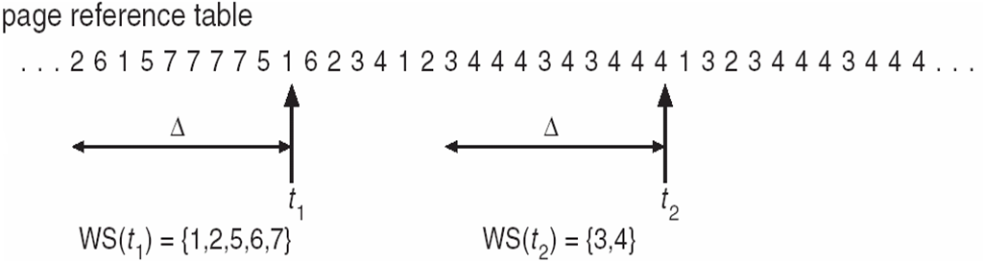
Working set model
D = Σ WSS _{i} ≡ total demand frames
  Approximation of locality
if D > m (total available frames) ⇒ Thrashing
Policy if D > m, then suspend or swap out one of the processes

Slide 10
Keeping Track of the Working Set
Approximate with interval timer + a reference bit
Example: ∆ = 10,000
  Timer interrupts after every 5000 time units
  Keep in memory 2 bits for each page
  Whenever a timer interrupts copy (to memory) and sets the values of all reference bits to 0
  If one of the bits in memory = 1 ⇒ page in working set
Why is this not completely accurate?
Improvement = 10 bits and interrupt every 1000 time units

Slide 11
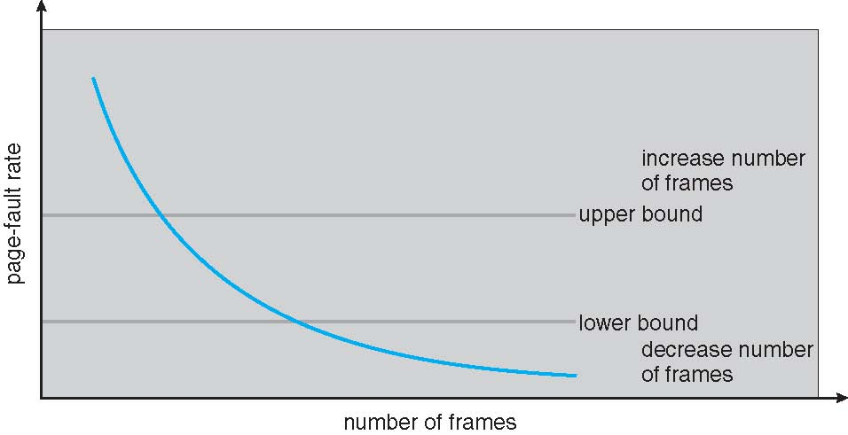
Page fault frequency
More direct approach than WSS
Establish “acceptable” page-fault frequency rate and use local replacement policy
  If actual rate too low, process loses frame
  If actual rate too high, process gains frame

Slide 12
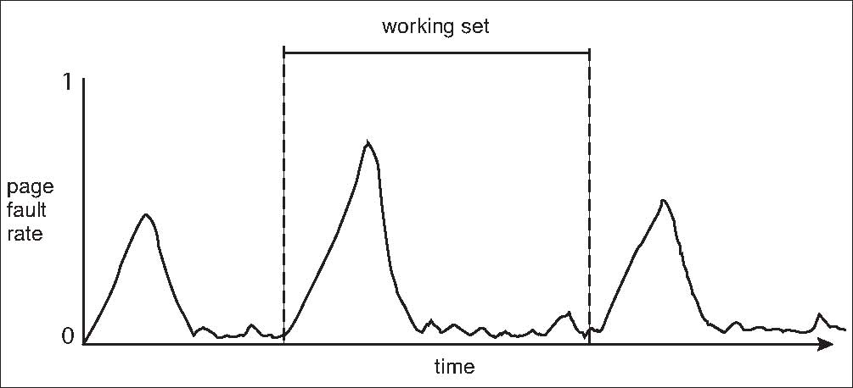
Working Sets and Page Fault Rates

Slide 13
Memory Mapped Files

Slide 14
Memory-Mapped Files
First, let’s see a demo of using mmap()

Slide 15
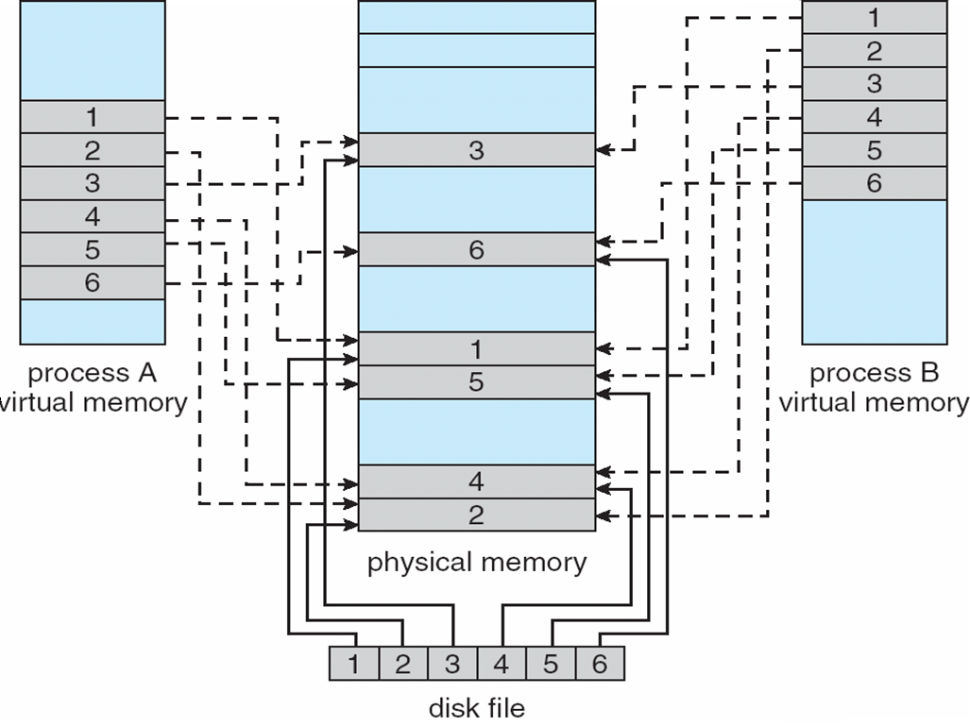
Memory-Mapped Files
Use MAP_SHARED flag

Slide 16
Memory-Mapped Files
Memory-mapped file I/O allows file I/O to be treated as routine memory access by mapping a disk block to a page in memory
A file is initially read using demand paging
  A page-sized portion of the file is read from the file system into a physical page
  Subsequent reads/writes to/from the file are treated as ordinary memory accesses
Simplifies and speeds file access by driving file I/O through memory rather than read() and write() system calls
Also allows several processes to map the same file allowing the pages in memory to be shared
But when does written data make it to disk?
  Periodically and / or at file close() time
  For example, when the pager scans for dirty pages

Slide 17
Memory-Mapped Files
Some OSes uses memory mapped files for standard I/O
Process can explicitly request memory mapping a file via mmap() system call
  Now file mapped into process address space
For standard I/O (open(), read(), write(), close()), mmap anyway
  But map file into kernel address space
  Process still does read() and write()
    Copies data to and from kernel space and user space
  Uses efficient memory management subsystem
    Avoids needing separate subsystem
COW can be used for read/write non-shared pages
Memory mapped files can be used for shared memory (although again via separate system calls)

Slide 18
Allocating Kernel Memory

Slide 19
Allocating kernel memory
Treated differently from user memory
Often allocated from a free-memory pool
  Kernel requests memory for structures of varying sizes
  Some kernel memory needs to be contiguous
  I.e. for device I/O

Slide 20
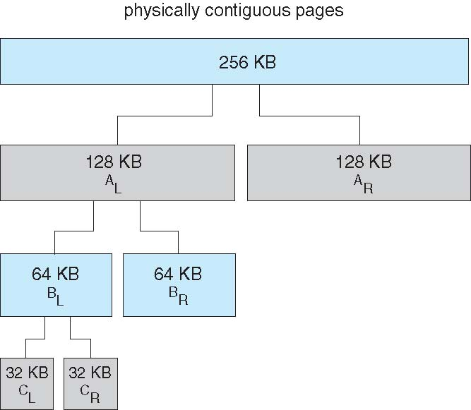
Buddy Allocator

Slide 21
Buddy Allocator
Allocates memory from fixed-size segment consisting of physically-contiguous pages
Memory allocated using power-of-2 allocator
  Satisfies requests in units sized as power of 2
  Request rounded up to next highest power of 2
  When smaller allocation needed than is available, current chunk split into two buddies of next-lower power of 2
  Continue until appropriate sized chunk available

Slide 22
Buddy Allocator
Continue until appropriate sized chunk available
For example, assume 256KB chunk available, kernel requests 21KB
  Split into AL and Ar of 128KB each
    One further divided into BL and BR of 64KB
      One further into CL and CR of 32KB each – one used to satisfy request
Advantage – quickly coalesce unused chunks into larger chunk
Disadvantage - fragmentation

Slide 23
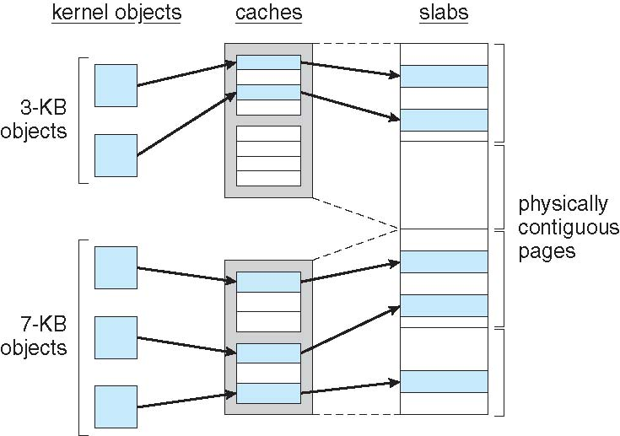
Slab Allocator

Slide 24
Slab Allocator
Alternate strategy
Slab is one or more physically contiguous pages
Cache consists of one or more slabs
Single cache for each unique kernel data structure
  Each cache filled with objects – instantiations of the data structure
When cache created, filled with objects marked as free
When structures stored, objects marked as used
If slab is full of used objects, next object allocated from empty slab
  If no empty slabs, new slab allocated
Benefits include no fragmentation, fast memory request satisfaction

Slide 25
Other considerations

Slide 26
Other Considerations -- Prepaging
To reduce the large number of page faults that occurs at process startup
Prepage all or some of the pages a process will need, before they are referenced
But if prepaged pages are unused, I/O and memory was wasted
Assume s pages are prepaged and α of the pages is used
  Is cost of s * α save pages faults > or < than the cost of prepaging
  s * (1- α) unnecessary pages?
  α near zero −−> prepaging loses

Slide 27
Page Size
Sometimes OS designers have a choice
  Especially if running on custom-built CPU
Page size selection must take into consideration:
  Fragmentation
  Page table size
  Resolution
  I/O overhead
  Number of page faults
  Locality
  TLB size and effectiveness
Always power of 2, usually in the range 2¹² (4,096 bytes) to 2²² (4,194,304 bytes)
On average, growing over time

Slide 28
TLB Reach
TLB Reach - The amount of memory accessible from the TLB
TLB Reach = (TLB Size) X (Page Size)
Ideally, the working set of each process is stored in the TLB
  Otherwise there is a high degree of page faults
Increase the Page Size
  This may lead to an increase in fragmentation as not all applications require a large page size
Provide Multiple Page Sizes
  This allows applications that require larger page sizes the opportunity to use them without an increase in fragmentation

Slide 29
Program Structure
Program structure
Int[128,128] data;
Each row is stored in one page
Program 1
for (j = 0; j <128; j++)
for (i = 0; i < 128; i++)
data[i,j] = 0;
128 x 128 = 16,384 page faults
Program 2
for (i = 0; i < 128; i++)
for (j = 0; j < 128; j++)
data[i,j] = 0;
128 page faults

Slide 30
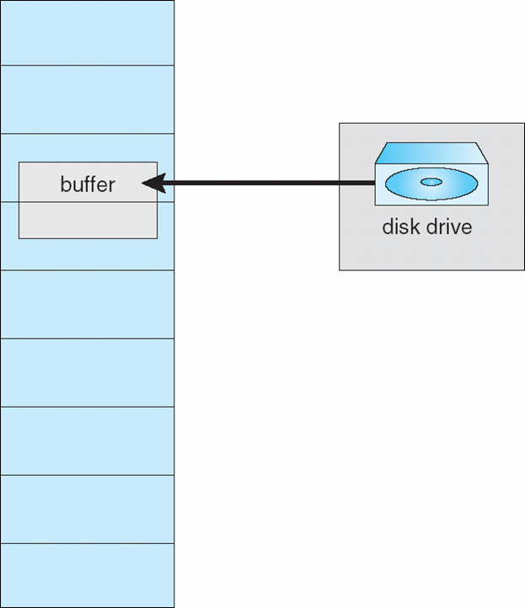
I/O Interlock
I/O Interlock – Pages must sometimes be locked into memory
Consider I/O - Pages that are used for copying a file from a device must be locked from being selected for eviction by a page replacement algorithm

